Slide 1
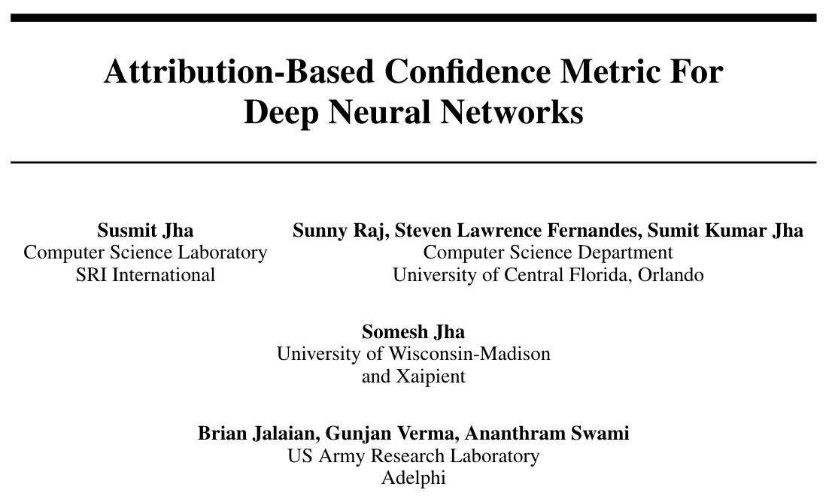

Slide 2
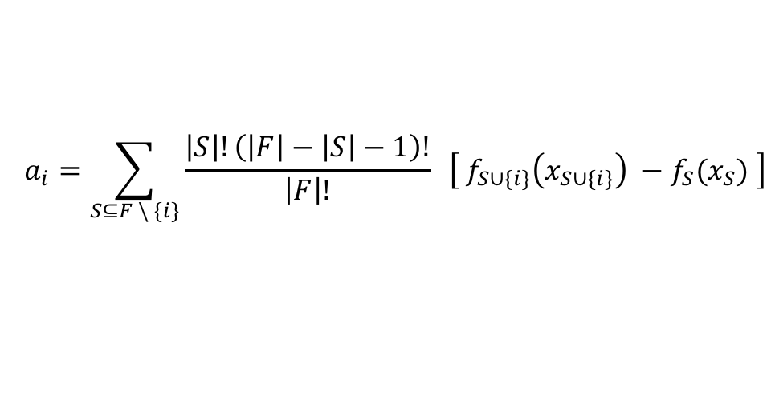
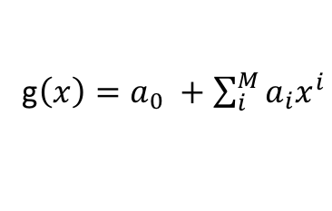
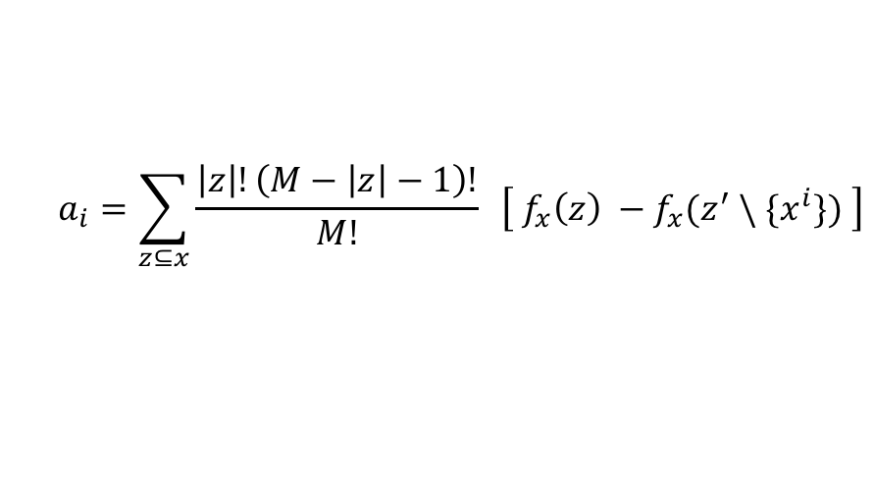
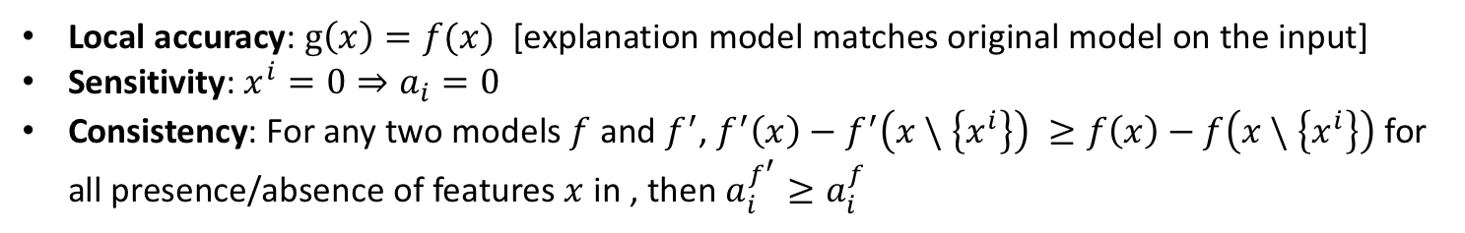
Attributions
Additive feature attribution locally: Boolean features - present or absent
g$\left(x\right)=a_{0} +\sum_{i}^{M}{a_{i}x^{i}}$
From cooperative game theory, we have classic equations to compute Shapley values
$$a_{i}=\sum_{S⊆F \backslash \{i\}}{\frac{\left|S\right|!\left(\left|F\right|−\left|S\right|−1\right)!}{\left|F\right|!} }\left[{ f}_{S∪\{i\}}\left(x_{S∪\{i\}}\right) −f_{S}(x_{S}) \right]$$
Local accuracy: $g\left(x\right)=f(x)$ [explanation model matches original model on the input]
Sensitivity: $x^{i}=0⇒a_{i}=0$
Consistency: For any two models $f$ and $f^{′}$, $f^{′}\left(x\right)−f^{′}\left(x \backslash \left\{x^{i}\right\}\right) ≥f\left(x\right)−f\left(x \backslash \left\{x^{i}\right\}\right)$ for all presence/absence of features $x$in , then $a_{i}^{f^{′}}≥a_{i}^{f}$
Young (1985) demonstrated that Shapley values are the only set of values that satisfy these properties.
$$a_{i}=\sum_{z⊆x}{\frac{\left|z\right|!\left(M−\left|z\right|−1\right)!}{M!} }\left[{ f}_{x}\left(z\right) −f_{x}(z^{′} \backslash \{x^{i}\}) \right]$$
Apply sampling approximations to above equation and approximate the effect of removing a variable from the model by integrating over samples.

Slide 3
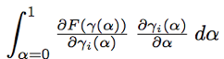
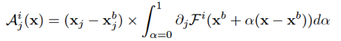
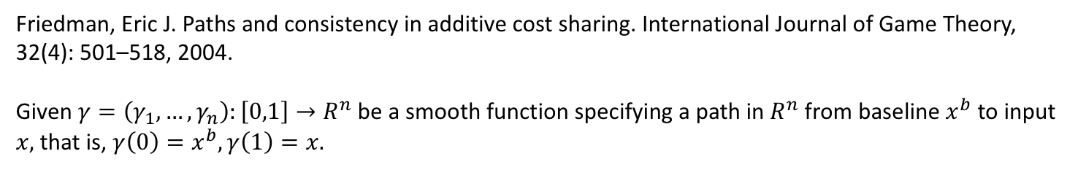
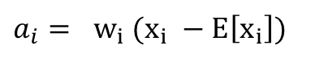
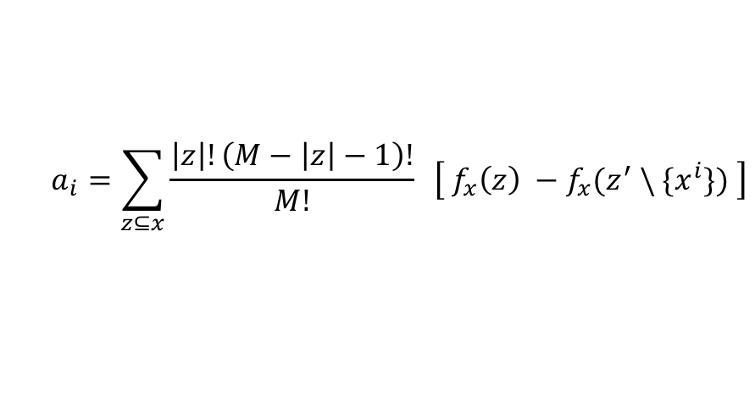
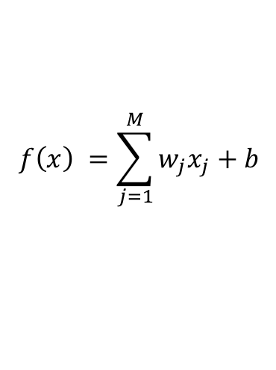
Shapley Values
Young (1985) demonstrated that Shapley values are the only set of values that satisfy these properties.
$$a_{i}=\sum_{z⊆x}{\frac{\left|z\right|!\left(M−\left|z\right|−1\right)!}{M!} }\left[{ f}_{x}\left(z\right) −f_{x}(z^{′} \backslash \{x^{i}\}) \right]$$
Apply sampling approximations to above equation and approximate the effect of removing a variable from the model by integrating over samples.
Baseline and path based methods.
Friedman, Eric J. Paths and consistency in additive cost sharing. International Journal of Game Theory, 32(4): 501–518, 2004.
Given $γ=\left(γ_{1}, …, γ_{n}\right):\left[0,1\right]→R^{n}$ be a smooth function specifying a path in $R^{n}$ from baseline $x^{b}$ to input $x,$ that is, $γ\left(0\right)=x^{b},γ\left(1\right)=x.$
IG. Sundararajan et. al.’17
Compositional
$$f\left(x\right) =\sum_{j=1}^{M}{w_{j}x_{j}}+b$$
$a_{i}= w_{i} (x_{i} −E\left[x_{i}\right])$

Slide 4
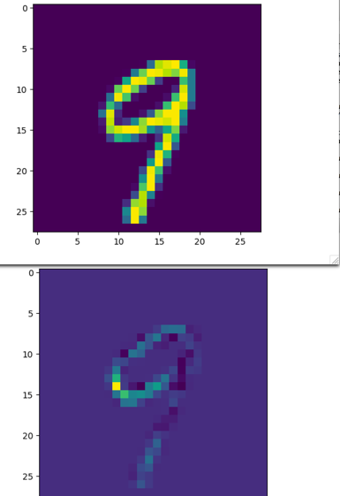
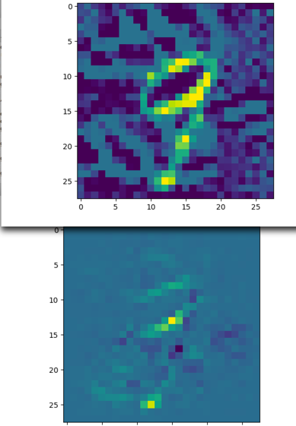
Sample Attributions ( 9 classified as 9, noisy 9 classified as 3)

Slide 5
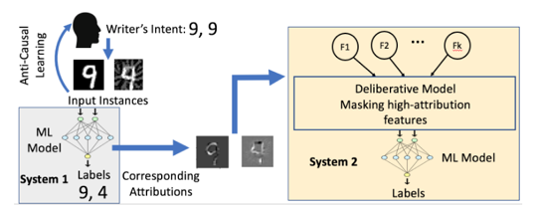
ABC: Attribution Based Confidence
If the model makes a prediction on an input robustly in the causal neighborhood, that is, there is redundancy of features on an input, then it is more confident.
For out-of-distribution or adversarial examples, the model’s prediction is not robust in causal space.

Slide 6
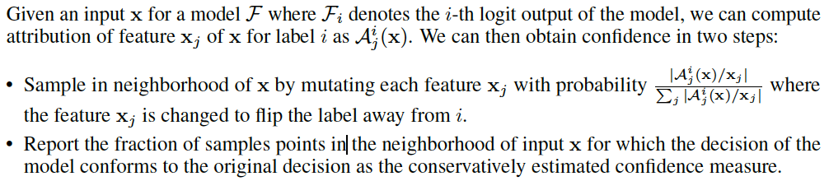
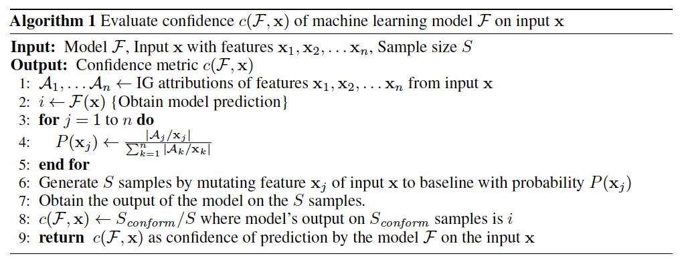
Attribution Based Confidence (ABC)

Slide 7
Attribution with Adversarial Attacks

Slide 8
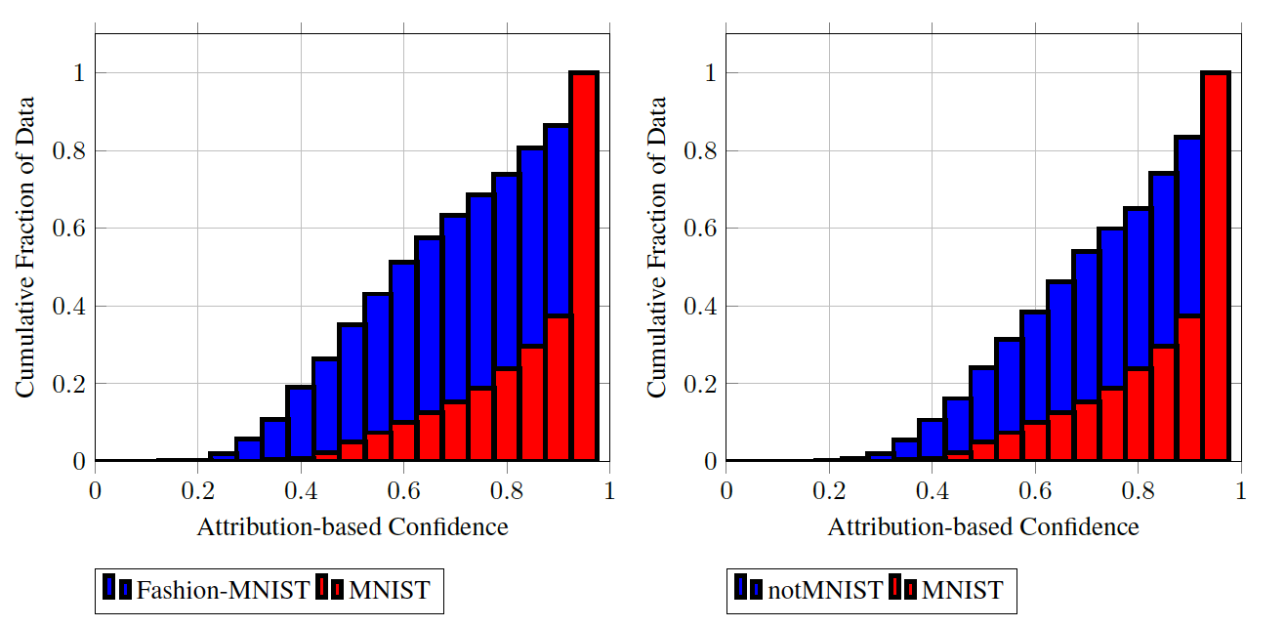
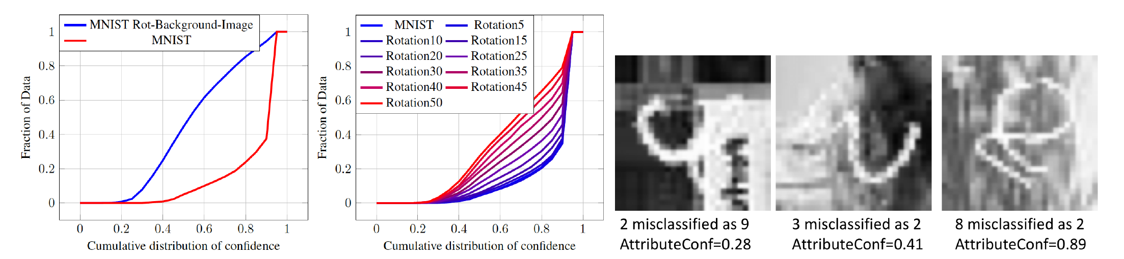
ABC: Attribution Based Confidence (MNIST)

Slide 9
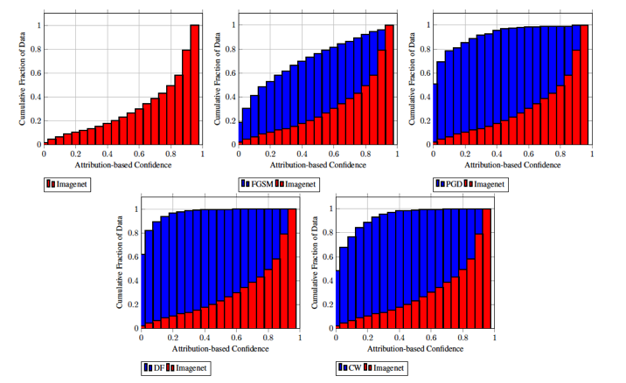
ABC: Attribution Based Confidence (ImageNet)

Slide 10
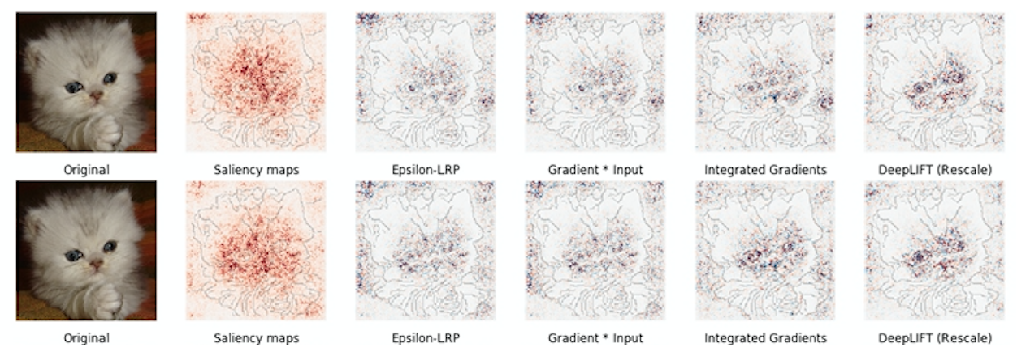
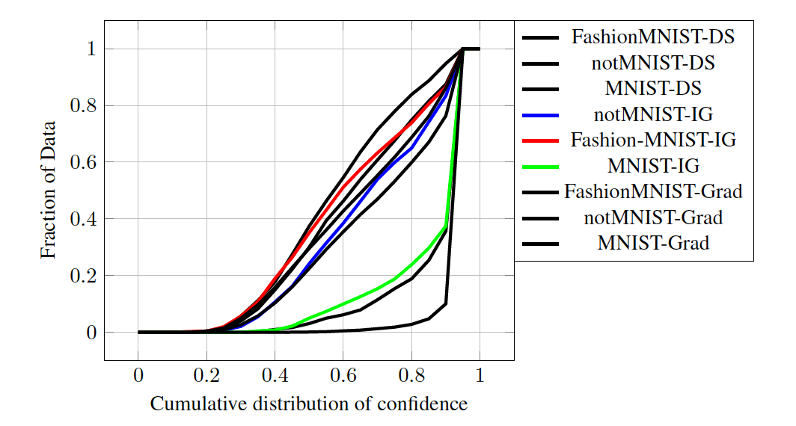
ABC: Different Attribution Methods

Slide 11
Conclusion
We propose a novel attribution-based confidence (ABC) metric computed by importance sampling in the neighborhood of a high-dimensional input using relative feature attributions, and estimating conformance of the model. It does not require access to training data or additional calibration.
We empirically evaluate the ABC metric over MNIST and ImageNet datasets using
out-of-distribution data,
adversarial inputs generated using digital attacks such as FGSM, PGD, CW and DeepFool, and
physically-realizable adversarial patches and LaVAN attacks.

